Slide 1
EFB 312- Lecture 2

Slide 2
Foreign Exchange Market
Interpreting Foreign Exchange Quotations
Direct versus indirect exchange rate over time
  When the US dollar is depreciating (based on a downward movement of the direct exchange rate) against the Australian dollar, the indirect exchange of the US dollar rate is rising
  When the US dollar is appreciating against the Australian dollar (based on an upward movement of the direct exchange rate of the US dollar), the indirect exchange rate of the US dollar is declining

Slide 3
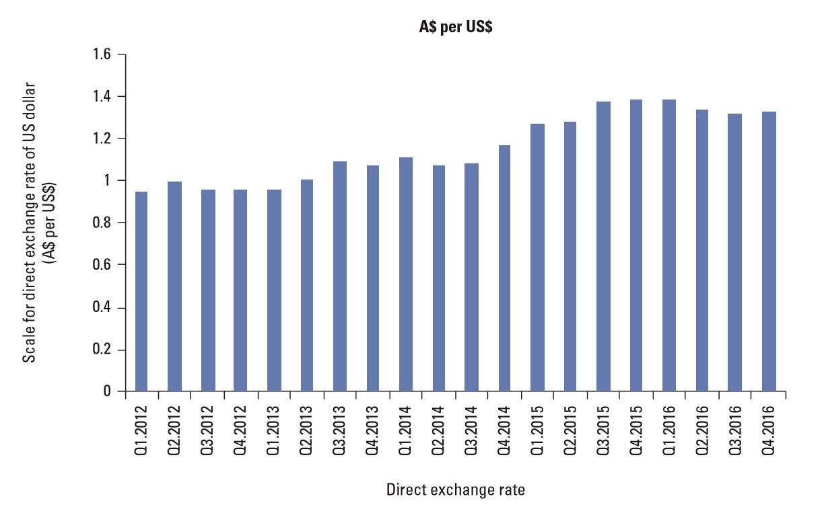
Relationship Over Time between the US DOLLAR’s Direct and Indirect Exchange Rates

Slide 4
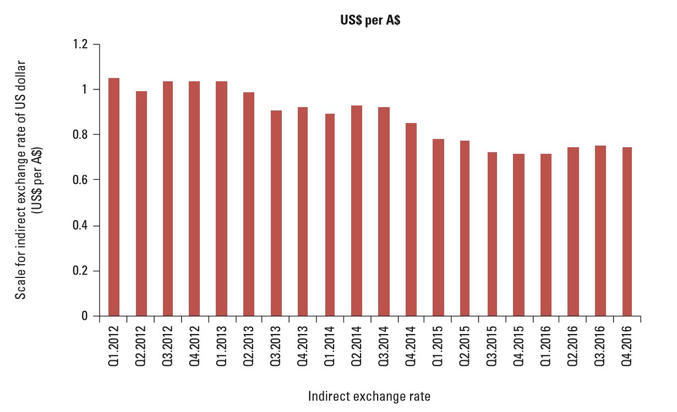
Relationship Over Time between the US DOLLAR’s Direct and Indirect Exchange Rates

Slide 5
Foreign Exchange Market
Interpreting Foreign Exchange Quotations
Cross Exchange Rates
  Cross exchange rate is the amount of one foreign currency per unit of another foreign currency
  Example
Value of yuan = A$0.1972
Value of MYR = A$0.35
Value of yuan in MYR = Value of yuan in A$
Value of MYR in A$
= A$0.1972 = MYR0.5634
A$0.35

Slide 6
Foreign Exchange Market
Interpreting Foreign Exchange Quotations
Currency Derivatives: A contract with a price that is partially derived from the value of the underlying currency that it represents
Forward Contracts: agreements between a foreign exchange dealer and MNC that specifies the currencies to be exchanged, the exchange rate, and the date at which the transaction will occur
  The forward rate is the exchange rate specified by the forward contract
  The forward market is the over-the-counter market where forward contracts are traded

Slide 7
Foreign Exchange Market
Interpreting Foreign Exchange Quotations
Currency futures contracts: similar to forward contracts but sold on an exchange
  Specifies a standard volume of a particular currency to be exchanged on a specific settlement date
  The futures rate is the exchange rate at which one can purchase or sell a specified currency on the specified settlement date
  The future spot rate is the spot rate that will exist at a future point in time and is uncertain as of today

Slide 8
Foreign Exchange Market
Interpreting Foreign Exchange Quotations
Currency Options Contracts
  Currency Call Option: provides the right to buy currency at a specified strike price within a specified period of time
  Currency Put Option: provides the right to sell currency at specified strike price within a specified period of time

Slide 9
International Money Market
Corporations or governments need short-term funds denominated in a currency different from their home currency.
The international money market has grown because firms:
  May need to borrow funds to pay for imports denominated in a foreign currency
  May choose to borrow in a currency in which the interest rate is lower
  May choose to borrow in a currency that is expected to depreciate against their home currency.

Slide 10
International Money Market
Origins and Development
European Money Market: Dollar deposits in banks in Europe and other continents are called Eurodollars or Eurocurrency. Origins of the European money market can be traced to the Eurocurrency market that developed during the 1960s and 1970s
Asian Money Market: Centred in Hong Kong and Singapore. Originated as a market involving mostly dollar-denominated deposits, and was originally known as the Asian dollar market

Slide 11
International Money Market
Money Market Interest Rates Among Currencies
The money market interest rates in any particular country are dependent on the demand for short-term funds by borrowers, relative to the supply of available short-term funds that are provided by savers
Money market rates vary due to differences in the interaction of the total supply of short-term funds available (bank deposits) in a specific country versus the total demand for short-term funds by borrowers in that country

Slide 12
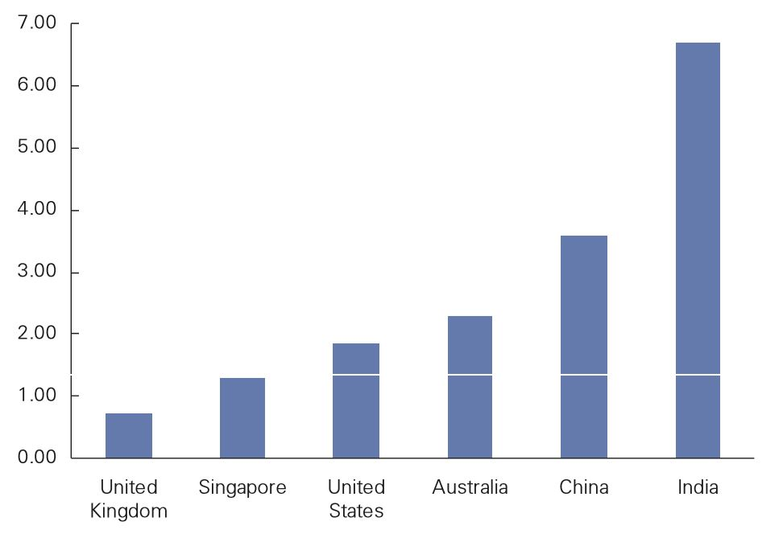
Comparison of 2017 International Money Market Interest Rates

Slide 13
International Money Market
Money Market Interest Rates Among Currencies
Global Integration of Money Market Interest Rates
  Money market interest rates among countries tend to be highly correlated over time.
  When economic conditions weaken, the corporate need for liquidity declines, and corporations reduce the amount of short-term funds they wish to borrow.
  When economic conditions strengthen, there is an increase in corporate expansion, and corporations need additional liquidity to support their expansion.

Slide 14
International Money Market
Money Market Interest Rates Among Currencies
Risk of International Money Market Securities
  International Money Market Securities are debt securities issued by MNCs and government agencies with a short-term maturity (1 year or less)
  Normally, these securities are perceived to be very safe from the risk of default
  Even if the international money market securities are not exposed to credit risk, they are exposed to exchange rate risk when the currency denominating the securities differs from the home currency of the investors

Slide 15
International Credit Market
MNCs sometimes obtain medium-term funds through term loans from local financial institutions or through the issuance of notes (medium-term debt obligations) in their local markets
Loans of 1 year or longer extended by banks to MNCs or government agencies in Europe are commonly called eurocredits or eurocredit loans
To avoid interest rate risk, banks commonly use floating rate loans with rates tied to the London Interbank Offer Rate (LIBOR)

Slide 16
International Bond Market
Foreign bonds are issued by borrower foreign to the country where the bond is placed
Eurobond market
Features of eurobonds
  Bearer bonds
  Annual coupon payments
  Convertible or callable
Denominations of eurobonds
  commonly denominated in a number of currencies

Slide 17
International Bond Market
Risk of International Bonds
Interest Rate Risk – potential for the value of bonds to decline in response to rising long-term interest rates.
Exchange Rate Risk – represents the potential for the value of bonds to decline (from the investor’s perspective) because the currency denominating the bond depreciates against the home currency.
Liquidity Risk – represents the potential for the value of bonds to decline because there is not a consistently active market for the bonds.
Credit Risk – represents the potential for default.
International Integration of Credit Risk – represents the higher credit risk in one country is transmitted to another country

Slide 18
Purchasing Power Parity (PPP)
Interpretations of Purchasing Power Parity
  Absolute Form of PPP
  Without international barriers, consumers shift their demand to wherever prices are lower.
  Prices of the same basket of products in two different countries should be equal when measured in common currency
  Relative Form of PPP
  Due to market imperfections, prices of the same basket of products in different countries will not necessarily be the same.
  However, the rate of change in prices should be similar when measured in common currency

Slide 19
Purchasing Power Parity (PPP)
Rationale Behind Relative PPP Theory
Exchange rate adjustment is necessary for the relative purchasing power to be the same whether buying products locally or from another country.
If the purchasing power is not equal, consumers will shift purchases to wherever products are cheaper until the purchasing power is equal.

Slide 20
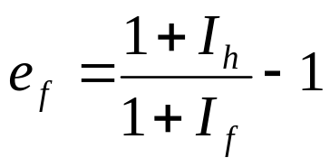
Purchasing Power Parity (PPP)
Derivation of Purchasing Power Parity
Relationship between relative inflation rates (I) and the exchange rate (e).

Slide 21
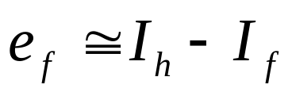
Purchasing Power Parity (PPP)
Using PPP to Estimate Exchange Rate Effects
The relative form of PPP can be used to estimate how an exchange rate will change in response to differential inflation rates between countries.
International trade is the mechanism by which the inflation differential affects the exchange rate according to this theory.
Simplified PPP relationship
  The percentage change in the exchange rate should be approximately equal to the difference in inflation rates between the two countries

Slide 22
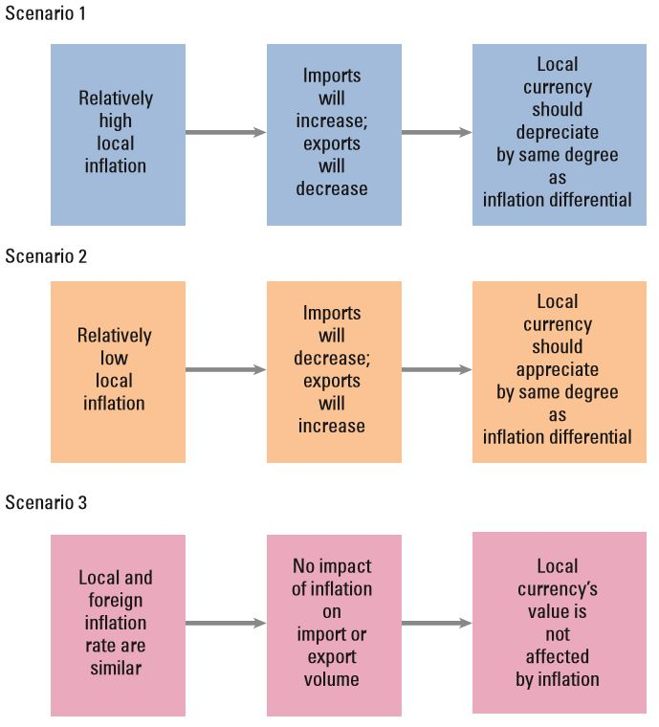
Summary of Purchasing Power Parity

Slide 23
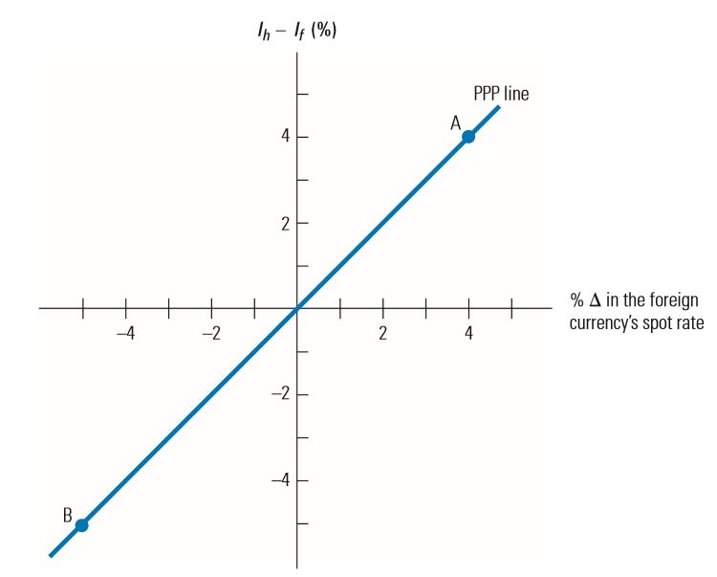
Illustration of Purchasing Power Parity

Slide 24
Purchasing Power Parity (PPP)
Graphic Analysis of Purchasing Power Parity
Using PPP theory, we should be able to assess the potential impact of inflation on exchange rates.
The points on the graph suggest that given an inflation differential between the home and the foreign country of X per cent, the foreign currency should adjust by X per cent due to that inflation differential.
PPP Line: The diagonal line connecting all these points together.

Slide 25
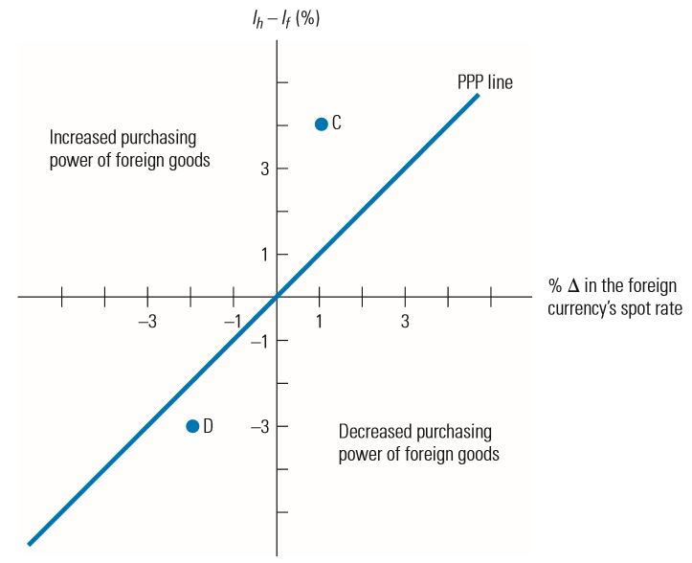
Identifying Disparity in Purchasing Power

Slide 26
Purchasing Power Parity (PPP)
Graphic Analysis of Purchasing Power Parity (cont.)
Purchasing Power Disparity
  Any points off of the PPP line represent purchasing power disparity.
  If the exchange rate does not move as PPP theory suggests, there is a disparity in the purchasing power of the two countries.
  Point C represents a situation where home inflation (I_{h}) exceeds foreign inflation (I_{f} ) by 4 per cent.
  Yet, the foreign currency appreciated by only 1 per cent in response to this inflation differential.
  Consequently, purchasing power disparity exists

Slide 27
Purchasing Power Parity (PPP)
Testing the Purchasing Power Parity Theory
Simple test of PPP
Choose two countries (such as the United States and a foreign country) and compare the differential in their inflation rates to the percentage change in the foreign currency’s value during several time periods
Statistical Test of PPP
Apply regression analysis to historical exchange rates and inflation differentials
Results of Statistical Tests of PPP
Deviations from PPP are not as pronounced for longer time periods, but they still exist. Thus, reliance on PPP to derive a forecast of the exchange rate is subject to significant error, even when applied to long-term forecasts

Slide 28
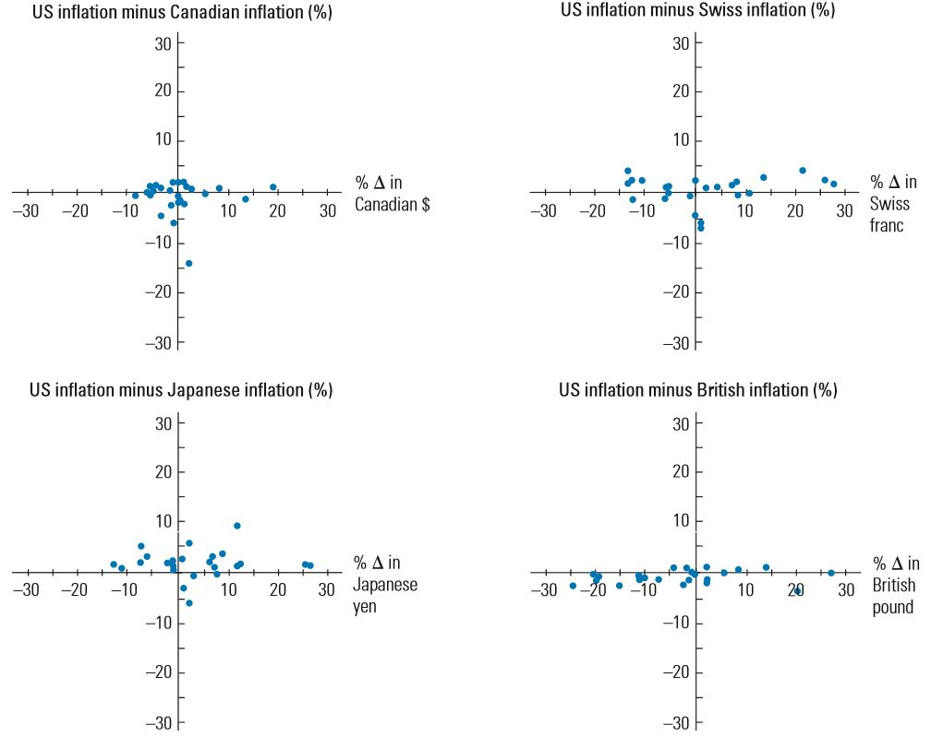
Comparison of Annual Inflation Differentials and Exchange Rate Movements for Four Major Countries

Slide 29
Purchasing Power Parity (PPP)
Testing the Purchasing Power Parity Theory
Limitation of PPP Tests
  Results vary with the base period used.
  Base period chosen should reflect an equilibrium position since subsequent periods are evaluated in comparison to it.
  If a base period is used when the foreign currency was relatively weak for reasons other than high inflation, most subsequent periods could show higher appreciation of that currency than what would be predicted by PPP.

Slide 30
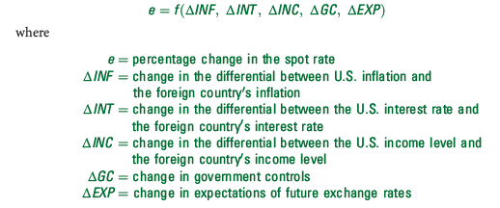
Purchasing Power Parity (PPP)
Why Purchasing Power Parity Does Not Hold
Confounding effects
  A change in a country’s spot rate is driven by more than the inflation differential between two countries:
  Since the exchange rate movement is not driven solely by ΔINF, the

Slide 31
Purchasing Power Parity (PPP)
Why Purchasing Power Parity Does Not Hold (cont.)
No Substitutes for Traded Goods
  If substitute goods are not available domestically, consumers may not stop buying imported goods

Slide 32
International Fisher Effect (IFE)
Fisher effect
Suggests that the nominal interest rate contains two components:
  Expected inflation rate
  Real interest rate.
The real rate of interest
Represents the return on the investment to savers after accounting for expected inflation

Slide 33
International Fisher Effect (IFE)
Using the IFE to Predict Exchange Rate Movements
Apply the Fisher Effect to Derive Expected Inflation per Country
  The first step is to derive the expected inflation rates of the two countries based on the Fisher effect.
  The Fisher effect suggests that nominal interest rates of two countries differ because of the difference in expected inflation between the two countries.
Rely on PPP to Estimate the Exchange Rate Movement
  The second step of the international Fisher effect is to apply the theory of PPP to determine how the exchange rate would change in response to those expected inflation rates of the two countries.

Slide 34
International Fisher Effect (IFE)
Implications of the International Fisher Effect
International Fisher effect (IFE) theory suggests that currencies with high interest rates will have high expected inflation (due to the Fisher effect).
Relatively high inflation will cause the currencies to depreciate (due to the PPP effect).
Implications of the IFE for Foreign Investors
  Implications are similar for foreign investors who attempt to capitalise on relatively high Australian interest rates.
  Foreign investors will be adversely affected by the effects of a relatively high Australian inflation rate if they try to capitalise on the high Australian interest rates.
Implications of the IFE for Two Non-Australian Currencies
  IFE theory can be applied to any exchange rate, even exchange rates that involve two non-Australian currencies.

Slide 35
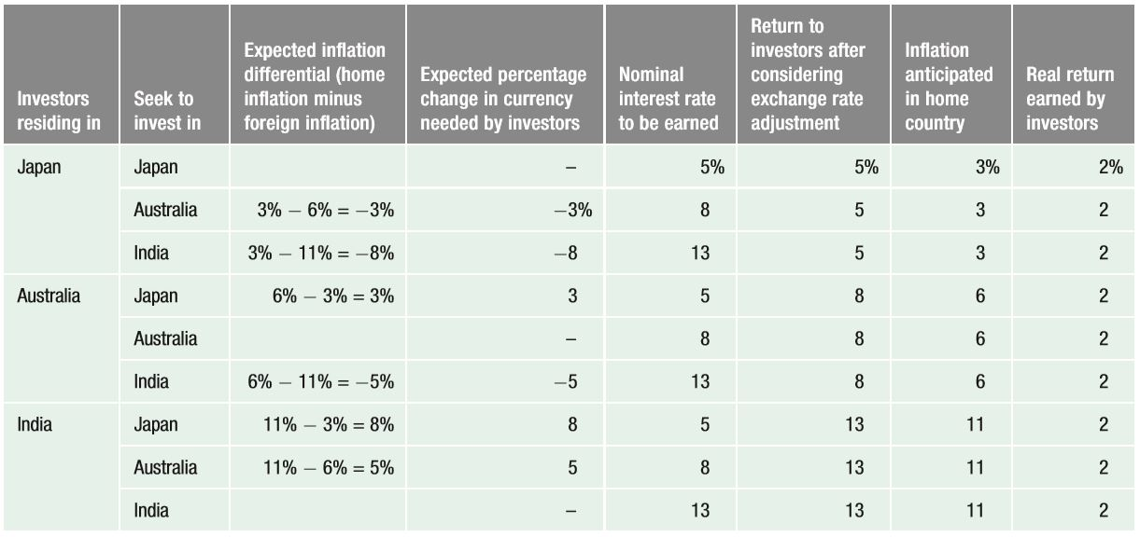
International Fisher Effect from Various Investor Perspectives

Slide 36
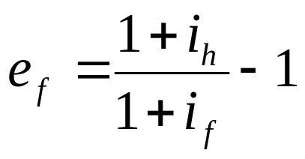
International Fisher Effect (IFE)
Derivation of the International Fisher Effect
Relationship between the interest rate (i) differential between two countries and expected exchange rate (e)

Slide 37
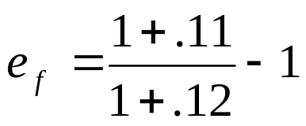

International Fisher Effect (IFE)
Derivation of the International Fisher Effect (cont.)
Numerical example based on derivation of the IFE
Assume that the interest rate on a one-year insured home country bank deposit is 11 per cent, and the interest rate on a 1-year insured foreign bank deposit is 12 per cent. For the actual returns of these two investments to be similar from the perspective of investors in the home country, the foreign currency would have to change over the investment horizon by the following percentage:

Slide 38
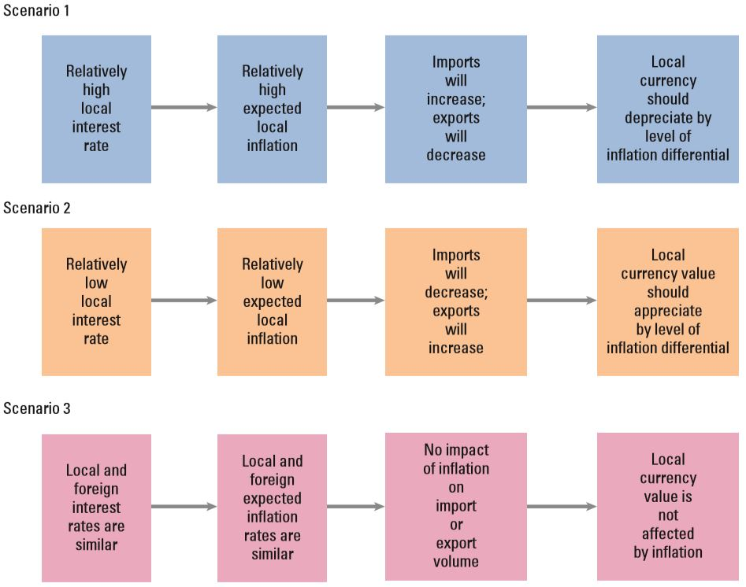
Summary of International Fisher Effect

Slide 39
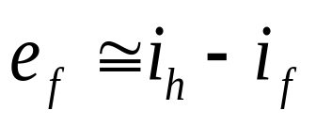
International Fisher Effect (IFE)
Derivation of the International Fisher Effect (cont.)
Simplified relationship

Slide 40
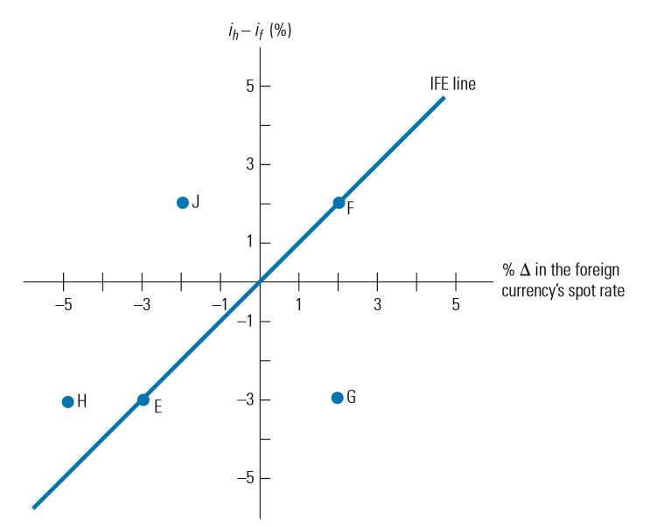
Illustration of IFE Line (When Exchange Rate Changes Perfectly Offset Interest Rate Differentials)

Slide 41
International Fisher Effect (IFE)
Graphic Analysis of the International Fisher Effect
Point E in reflects a situation where the foreign interest rate exceeds the home interest rate by three percentage points.
Foreign currency has depreciated by 3% to offset its interest rate advantage.
Point F represents a home interest rate 2 per cent above the foreign interest rate.
IFE theory suggests that the currency should appreciate by 2 per cent to offset the interest rate disadvantage
Point F illustrates the IFE from a foreign investor’s perspective. The home interest rate will appear attractive to the foreign investor. However, IFE theory suggests that the foreign currency will appreciate by 2 per cent

Slide 42
International Fisher Effect (IFE)
Graphic Analysis of the International Fisher Effect (cont.)
Points on the IFE Line
  All the points along the IFE line reflect exchange rate adjustments to offset the differential in interest rates.
  This means investors will end up achieving the same yield (adjusted for exchange rate fluctuations) whether they invest at home or in a foreign country.
Points below the IFE Line
  Points below the IFE line generally reflect the higher returns from investing in foreign deposits.
Points above the IFE Line
  Points above the IFE line generally reflect returns from foreign deposits that are lower than the returns possible domestically.

Slide 43
Tests of the International Fisher Effect
What Can be Tested
  If the actual points (one for each period) of interest rates and exchange rate changes were plotted over time on a graph, we could determine whether:
    the points are systematically below the IFE line (suggesting higher returns from foreign investing),
    above the line (suggesting lower returns from foreign investing), or
    evenly scattered on both sides (suggesting a balance of higher returns from foreign investing in some periods and lower foreign returns in other periods).
Next slide displays a set of points that tend to support the IFE theory.
Statistical Test of the IFE
    Apply regression analysis to historical exchange rates and the nominal interest rate differential.

Slide 44
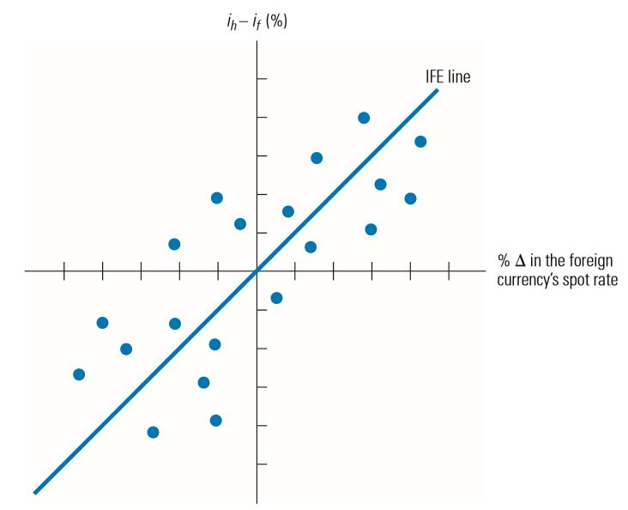
Illustration of IFE Concept (Exchange Rate Changes Offsetting Interest Rate Differentials on Average)

Slide 45
Tests of the International Fisher Effect
Limitations of the IFE
The IFE theory relies on the Fisher effect and PPP
Limitation of the Fisher Effect
  The difference between the nominal interest rate and actual inflation rate is not consistent.
  Thus, while the Fisher effect can effectively use nominal interest rates to estimate the market’s expected inflation over a particular period, the market may be wrong.
Limitation of PPP
  Other country characteristics besides inflation (income levels, government controls) can affect exchange rate movements.
  Even if the expected inflation derived from the Fisher effect properly reflects the actual inflation rate over the period, relying solely on inflation to forecast the future exchange rate is subject to error.

Slide 46
Tests of the International Fisher Effect
IFE Theory versus Reality
IFE theory contradicts how a country with a high interest rate can attract more capital flows and therefore cause the local currency’s value to strengthen.
IFE theory also contradicts how central banks may purposely try to raise interest rates in order to attract funds and strengthen the value of their local currencies.
Whether the IFE holds in reality is dependent on the countries involved and the period assessed.
IFE theory may be especially meaningful to situations in which the MNCs and large investors consider investing in countries where the prevailing interest rates are very high.

Slide 47
Practice question
Beth Miller does not believe that the international Fisher effect (IFE) holds. Current one-year interest rates in Europe are 5 per cent, while one-year interest rates in Australia are 3 per cent. Beth converts A$100,000 to euros and invests them in Germany. One year later, she converts the euros back to Australian dollars. The current spot rate of the euro is A$1.35.
According to the IFE, what should the spot rate of the euro in one year be?
If the spot rate of the euro in one year is A$1.00, what is Beth’s percentage return from her strategy?
If the spot rate of the euro in one year is A$1.15, what is Beth’s percentage return from her strategy?
What must the spot rate of the euro be in one year for Beth’s strategy to be successful?

